Slide 1


History & Context for Peer Verification
Ruby Woodside, Innovative Services Manager,
Second Nature
rwoodside@secondnature.org

Slide 2

Second Nature Guidance on Carbon Neutrality
Scope 1 = All
Scope 2 = All
Scope 3 = Air travel paid for by or through the institution, regular commuting to and from campus
Scope 1
On Campus Combustion/ Fuel Use
Scope 2
Purchased Electricity
Scope 3
Travel & Commuting

Slide 3

Carbon Markets & Offsets Guidance
Developed by the Offset Technical Advisory Group in 2016.
The Commitments allow for Scope 3 emissions up to a total limit of 30% of the total campus emissions to be offset by “peer-reviewed” or “innovative” (limit of 10% of total campus emissions) offset projects.

Slide 4
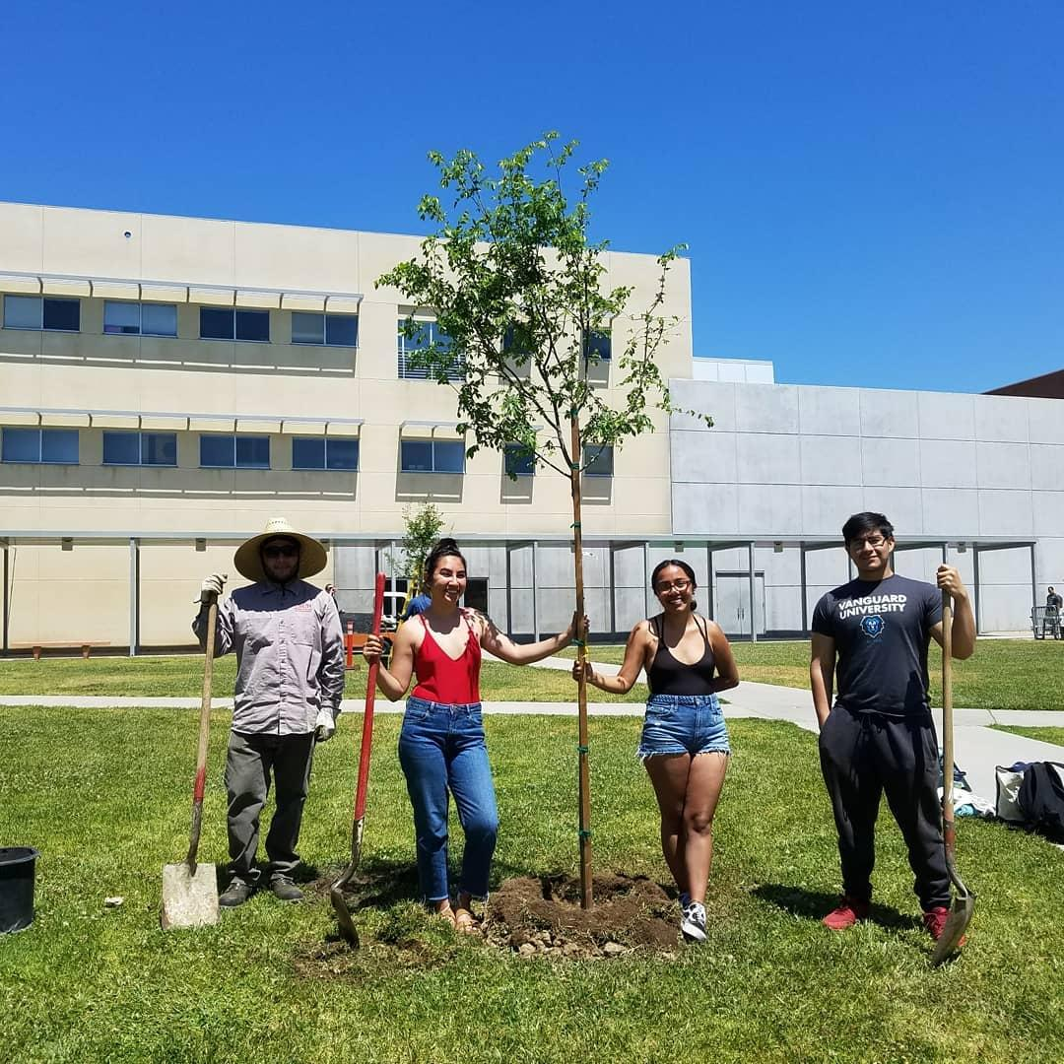
Carbon Markets & Offsets Guidance
Goals of Peer-Reviewed & Innovative Offsets
Leverage educational & research capacities of schools
Advance science of addressing climate change
Demonstrate leadership in developing new offset protocols
Develop educational opportunities for students
Develop projects with co-benefits

Slide 5
Offset Network Development
Peer Review Committee
Structure-building subcommittee
Resources & guidance subcommittee

Slide 6



Types of Carbon Offsets
Least Robust/ Most Flexible Requirements
Most Robust/ Strictest Requirements
✓
Innovative Offsets
Peer Reviewed Offsets
Traditional Offsets
Innovative Offsets
Apply to Scope 3 only, can offset up to 10% of total emissions
Peer Reviewed Offsets
Apply to Scope 3 only, can offset up to 30% of total emissions
Traditional Offsets
Can apply to any Scope and are marketable
Undergo Peer Verification
Notes:
Focusing on traditional offsets

Slide 7
What are Peer Reviewed & Innovative Offsets?
Peer Reviewed Offsets
Use an existing, approved protocol (through voluntary carbon market programs such as CAR, VCS. Could also look for existing protocols through DCOI)
Must meet all PAVER requirements
Peer verifiers will review and ensure all PAVER requirements are met, protocol is followed correctly, emissions reductions are real
Innovative Offsets
May use a newly developed protocol, new type of offset project
Must meet most PAVER requirements
Must include transition document describing how project will meet all PAVER requirements in the future
Peer verifiers will review project and confirm that most PAVER requirements met

Slide 8
Accounting for Peer Reviewed & Innovative Offsets

