Slide 1
​
Introduction to Urban Forest Management Protocol
Cindy Chiang, Business Development Manager
Duke Offsets Network Peer Verification Workshop
April 2nd, 2019

Slide 2
Agenda
Introduction
Role of carbon registries and protocols
Urban Forest protocol background
Protocol overview
Verification
Reserve’s verification approach
Verifying UFM projects

Slide 3
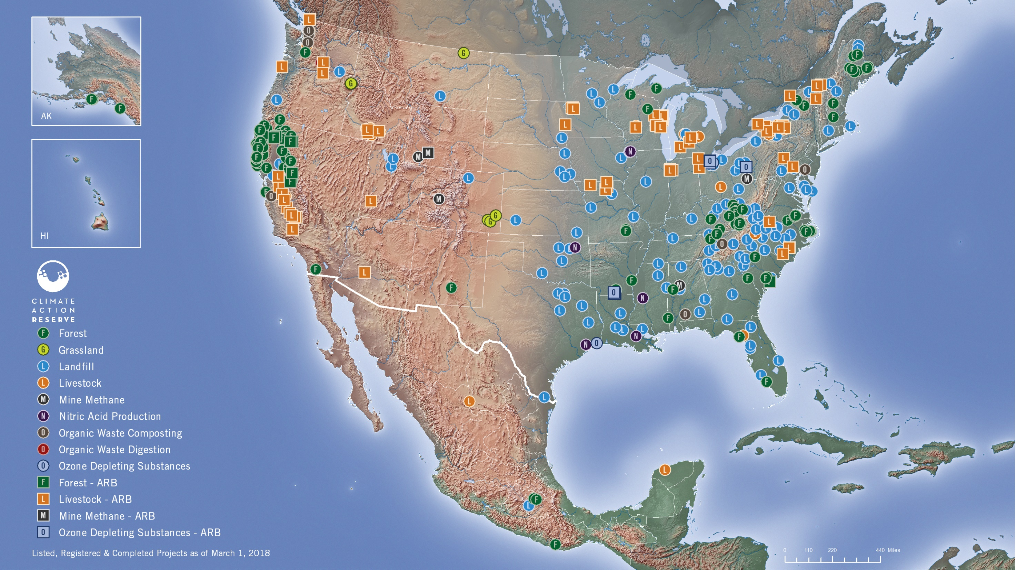
CLIMATE ACTION RESERVE
Nonprofit, founded 2001
Voluntary carbon offset registry
California compliance Offset Project Registry
Develop standardized carbon offset protocols
GHG policy support
Notes:
Board comprised of representatives of government, business, environmental, and academic sectors
Cal EPA, NRDC, CA Farm Bureau Federation, Sacramento MUD, CA Natural Resources Agency, Clean Energy Advantage Partners, LA County, FERC, EDF
Registry services:
Program administration: the paperwork/implementation, the listing, registering on the registry aka online database, COI, agreement execution, verification doc review, audits, etc.
Policy side: monitoring developments in science, tech, and policy to continually update protocols, looking at barriers to implementation; dev tools, trainings, education support
More than 75% of N.Am credits used to balance against emissions voluntarily in 2016 are Reserve-issued credits

Slide 4
Carbon registries protect the environmental integrity of offsets
Registries provide structure, rigor, and transparency to build confidence in the carbon market
Policy development for standardized offset project protocols
Provide project eligibility rules, methods for GHG quantification, monitoring and reporting requirements
Monitor and apply developments in science, tech, and policy
Assess barriers to project implementation
Develop tools, trainings, and educational offerings
Program infrastructure for the issuance and tracking of offsets
Administrative services for project listing and registration
Manage online registry of credits
Agreement execution
Verifier/Verification Body oversight
Periodic onsite audits
Notes:
Registry provide environmental integrity, transparency, rigor, and accuracy in carbon market through high quality standards for the development, quantification, and verification of GHG emissions reduction projects. So that markets can confidently direct financing towards mitigation projects in an efficient and credible way.
Program administration: the paperwork/implementation, the listing, registering on the registry aka online database, COI, agreement execution, verification doc review, audits, etc.
Policy side: monitoring developments in science, tech, and policy to continually update protocols, looking at barriers to implementation; dev tools, trainings, education support
Engage with government, industry, academia, and technical stakeholders, plus public comment
Offset Project Protocols
Provide project eligibility rules
Methods to quantify a project’s net effect on GHG emissions
Procedures for assessing risk
Monitoring and reporting

Slide 5
Overarching GHG accounting principles
Real
Additional
Permanent
No Double Counting
Verifiable
GHG accounting is conservative, comprehensive, and scientifically credible
Ex-post third-party verification prior to credit issuance
GHG reductions would not have occurred in the absence of the carbon market
GHG reductions or removals persist for at least 100 years
No other parties may reasonably claim ownership of GHG reductions
Notes:
Standards protects the environmental and financial value of your carbon credits by ensuring that GHG reductions and removals caused by a project are accounted for in a complete, consistent, transparent, accurate, and conservative manner
Offset Project Protocols
Provide project eligibility rules
Methods to quantify a project’s net effect on GHG emissions
Procedures for assessing risk
Monitoring and reporting
If a project meets these criteria, the standard will issue carbon offsets equivalent to the emissions reductions. Project developers can then transact these offsets directly to end buyers, who can claim the emissions reductions as their own if they retire and remove the offsets from circulation. In other cases, project developers sell to retailers or brokers, who then resell or charge a fee for finding end buyers.

Slide 6
How are offsets generated?
The Reserve develops standardized offset protocols
Engage with government, industry, academia, and technical stakeholders, plus public comment and board approval
Public listing
Third-party verification
CRT issuance & trading
Registry review
Project development
REPEAT
Notes:
Standards protects the environmental and financial value of your carbon credits by ensuring that GHG reductions and removals caused by a project are accounted for in a complete, consistent, transparent, accurate, and conservative manner
Offset Project Protocols
Provide project eligibility rules
Methods to quantify a project’s net effect on GHG emissions
Procedures for assessing risk
Monitoring and reporting
If a project meets these criteria, the standard will issue carbon offsets equivalent to the emissions reductions. Project developers can then transact these offsets directly to end buyers, who can claim the emissions reductions as their own if they retire and remove the offsets from circulation. In other cases, project developers sell to retailers or brokers, who then resell or charge a fee for finding end buyers.

Slide 7
Protocol development background
Scoping and developing UFPP v1.0 with workgroup (82 participants)
UFPP v1.0
UFPP v1.1
UFT 2.0
2007-2008
2008
2010
2013-2014
2014
2017
2019
UFM v1.0
Scoping changes to quantification to address lower cost of project development
UFM v1.1
Scoping protocol overhaul to 2.0 (16 participants)
Notes:
2010 UFPP update
Updated project start date language to be consistent with Reserve start date policy
Added methodology for quantifying GHG emissions from vehicles and equipment for municipalities with insufficient data
Clarified the project reporting and verification schedules
Added the verification protocol guidance to the project protocol
2014 UFM 1.0
The Urban Forest Management (UFM) Project Protocol Version 1.0 is a new protocol that incorporates guidance and requirements from the Urban Forest Project Protocol Version 1.1 but also allows for improved management of urban trees (carbon stocks). The protocol was adopted by the Reserve Board of Directors on June 25, 2014.
ARB UFP 1.0 2011

Slide 8
Project definition: maintain or increase carbon inventories relative to baseline levels
Activities focus on increasing sequestration by planting new trees and maintaining existing trees
Projects must be located within Urban Areas, Urban Clusters, Census Designated Places, or Incorporated Places as defined by the US Census Bureau
Projects must be a minimum of 25 acres
Notes:
Increasing sequestration by removing diseased and suppressed trees
Reducing emissions by avoiding tree removals
Planting new trees
Monitoring, protecting, and treating trees to avoid premature mortality from stressors such as drought, pests, storm damage, and abiotic agents
Reducing the vulnerability of trees to impacts of climate change by increasing resilience

Slide 9
Project ownership
Urban Forest Owners: entity with legal control of urban forest carbon within the Project Area
City
County
State agency
Educational campus
Corporation (i.e.: utility or special districts)
Individuals
Owners may combine forest carbon with other Owners to increase project scale
Project Operators: ultimately responsible for all project listing, monitoring, reporting, and verification
POs must be a Owner or an entity with legal authority to represent the Owners
Notes:
Having control of urban forest carbon means the Urban Forest Owner has the legal authority to effect changes to urban forest carbon quantities (right to plant or remove trees, for example). Control of urban forest carbon may be conveyed, for purposes of satisfying this protocol, through fee ownership, perpetual contractual agreements, deeded encumbrances, or other legal provisions. This protocol recognizes the fee owner as the default owner of urban forest carbon where no explicit legal encumbrance exists.

Slide 10
Additionality
Legal requirement test
GHG removals must be beyond removals required by any law, statute, rule, regulation, or ordinance, or any other legally binding mandates
Any Legal Agreements (i.e.: deeded encumbrances) must be considered as legal constraints on the project
Baseline trend must account for any legal constraints
Performance standard test
GHG removals achieved by project must be beyond removals that result from BAU activities
Projects automatically satisfy the performance standard by maintaining carbon stocks above the baseline
Enhancement Payments may be pursued to support project activities
California Climate Investments (CCI), formerly, GGRF
USFS grants and agreements

Slide 11
Quantification overview: Project CO₂ = Canopy Area x Ratio Estimator
Carbon storage based on relationship between canopy cover and carbon storage
Ratio Estimators: the amount of carbon per acre of canopy cover
GHG assessment boundary: standing live and standing dead carbon
Measuring project canopy cover is crucial; data and tools used are not limited
Remote sensing
Satellite imagery
Tools like i-Tree Canopy
General steps
Estimate baseline onsite carbon stocks
Determine actual onsite carbon stocks
Calculate the project’s Primary Effect
Canopy
Notes:
Ratio estimators (RE) = ratio of CO₂e per unit area of canopy cover
data and tools used to measure the canopy area are not limited and may include a variety of remotely sensed data and automated digitizing, as well as manual digitizing.

Slide 12
Ratio estimators
Ratio estimators (RE) = ratio of CO₂e per unit area of canopy cover
Defaults values based on Nowak et. al. 2013 study
Site-visits are not required for projects using default REs
Project developers have the option to develop project-specific ratio estimators
Must maintain ground based inventory
Notes:
Greg McPherson et al, 2017
Nowak, 2013 (USFS)

Slide 13
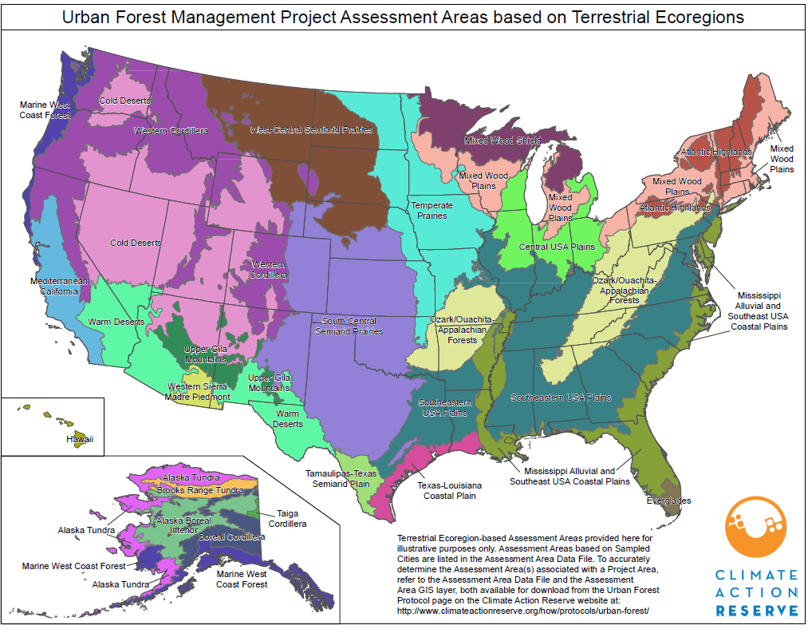
Assessment Areas
Defined geographic areas with corresponding default Ratio Estimators
CEC’s Terrestrial Ecoregions
Sampled cities from Nowak et al 2013 study
Notes:
Will/plan to accept other studies as new data becomes available. Starting with Nowak for now as that’s the best available research to date.
The cities and urban areas in the Reserve’s UFM Assessment Area table that have been discretely sampled to develop ratio estimators are referred to as Sampled Cities for purposes of UFM Protocol.
For urban areas and cities that do not have discrete data, default ratio estimators were developed and scaled to the U.S. by applying the most conservative ratio estimator from Sampled Cities to its corresponding Assessment Area.
UFM Assessment Areas include Sampled Cities and Terrestrial Ecoregions delineated by the Commission for Environmental Cooperation, an intergovernmental organization established by the North American Agreement on Environmental Cooperation. Terrestrial Ecoregions are areas of general similarity in ecosystems and in the type, quality, and quantity of environmental resources. Where Sampled Cities and Terrestrial Ecoregions coincide, Sampled Cities define the Assessment Area boundaries and default ratio estimators. A complete list of Assessment Areas and their corresponding default ratio estimators (tonnes/acre) for the U.S. can be found on the Reserve’s Urban Forest Project webpage. This table will be maintained and updated as new data become available.
http://www.cec.org/tools-and-resources/map-files/terrestrial-ecoregions-level-ii

Slide 14
Estimating project canopy cover
Total canopy of trees must be measured or estimated (via sampling)
Satellite image used must be dated within 12 months of project commencement date
If measured
Entire canopy cover for the Project Area will be mapped as a layer in a GIS
Data and tools used are not limited, and will be reviewed by verifier for statistical accuracy
If sampled, can use:
Randomized points developed using i-Tree Canopy
Systematic sample can be conducted with a grid of points in GIS
Sampling can be conducted using remotely sensed data as a subset of the Project Area
Canopy cover estimates must be within +/- 5% at 1 standard error

Slide 15
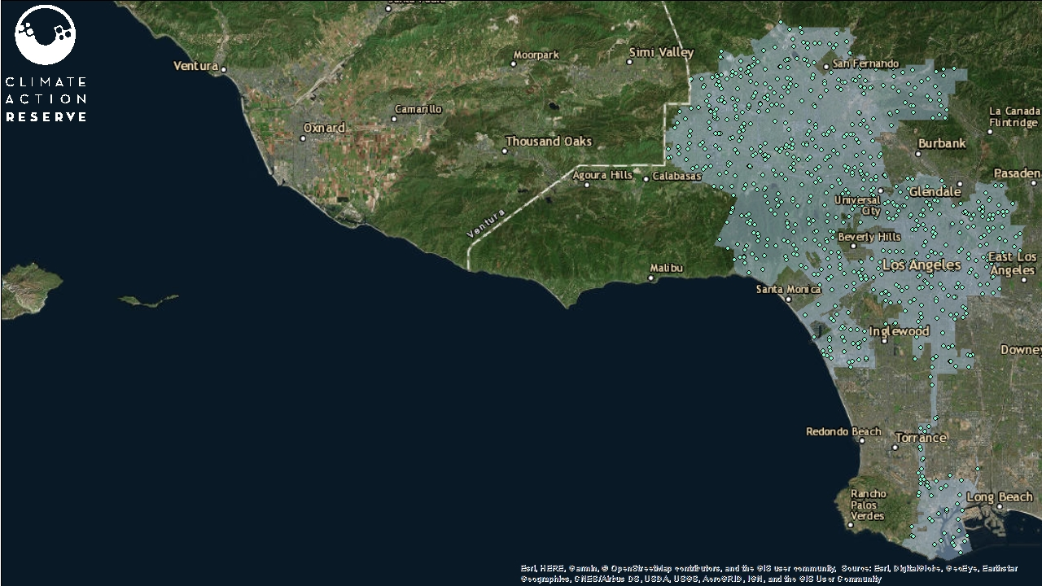
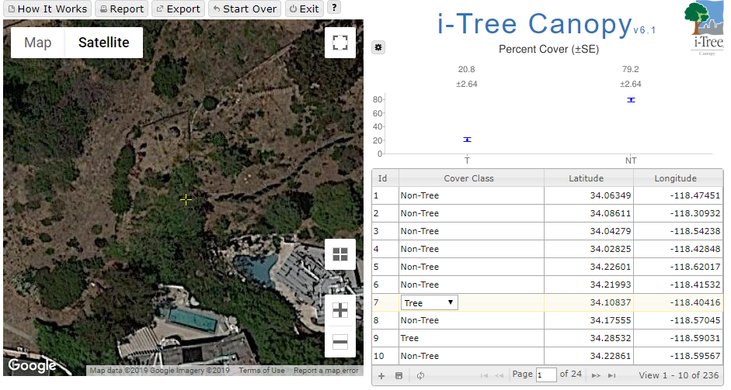
Mean Estimate of Canopy Cover at +/- 2.63% at 1 SE | Total Project Area (acres) | Total Canopy within Project Area (acres) | Ratio Estimator (CO₂e/acre of canopy cover) | Total CO₂e (tonne)
20.8% | 447,631 acres | 93,107 | 68 | 6,331,292
Notes:
800+ points in iTree
About an hour and half

Slide 16
Project baseline
Trend line developed based on two historic canopy cover estimates
Estimates must be at least 10 years apart and no earlier than 1990
Canopy cover estimates based on i-Tree Canopy, or other aerial/historical imagery
Example: project commences in 2018, historical estimate may be aerial imagery from 2005 and 2015
Ratio estimator(s) applied to the two historic canopy cover areas
Slope of two points of inventory is continued into the future for 25 years, then held steady for the life of the project
Notes:
determination of canopy area with +/- 5% at 1 Standard Error. The percentage canopy area determined by the verifier must be within 5% of the estimate provided by the Project Operator, depending on project size

Slide 17
Urban Forest Management Project crediting- baseline trend with decreasing stocks
CO₂e tonnes
per acre
Initial carbon stocks are estimated
Project baseline is established based on slope of the 2 historical canopy estimates
Credits are given for the difference between project and baseline stocks
Two historical images used to establish the trendline
Time
(100 years)
Project start date
Project year 25

Slide 18
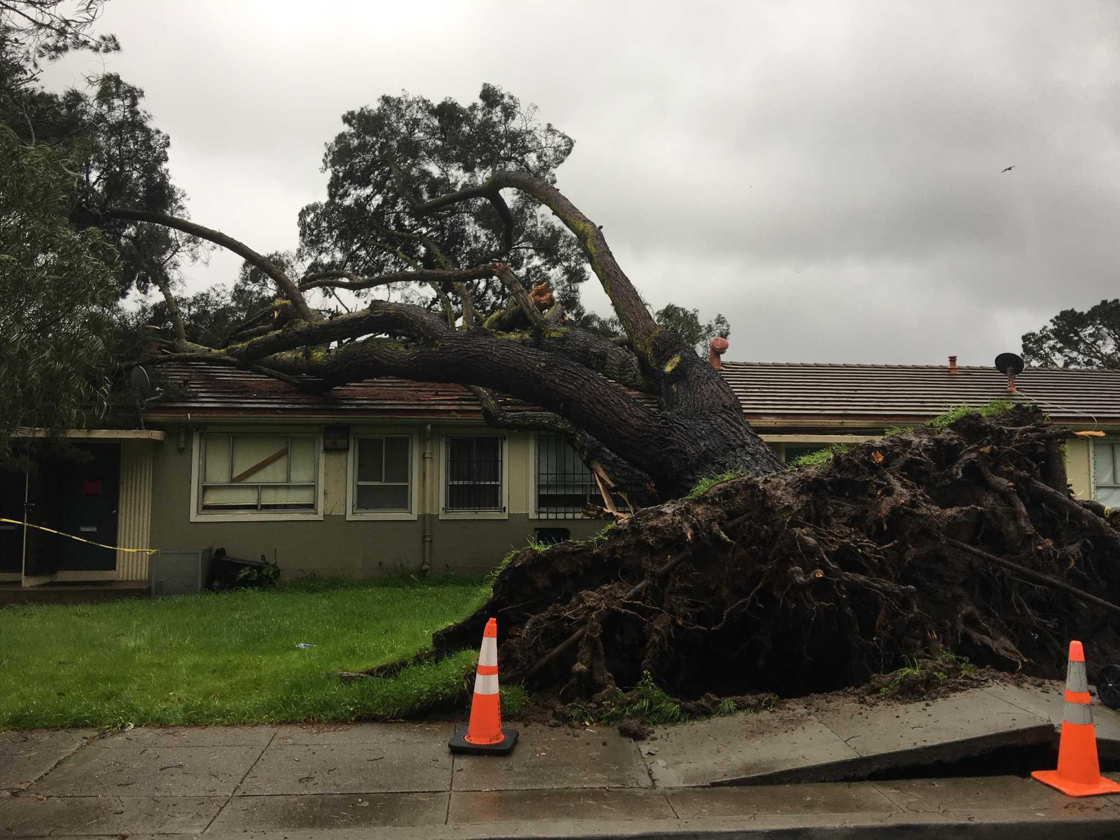
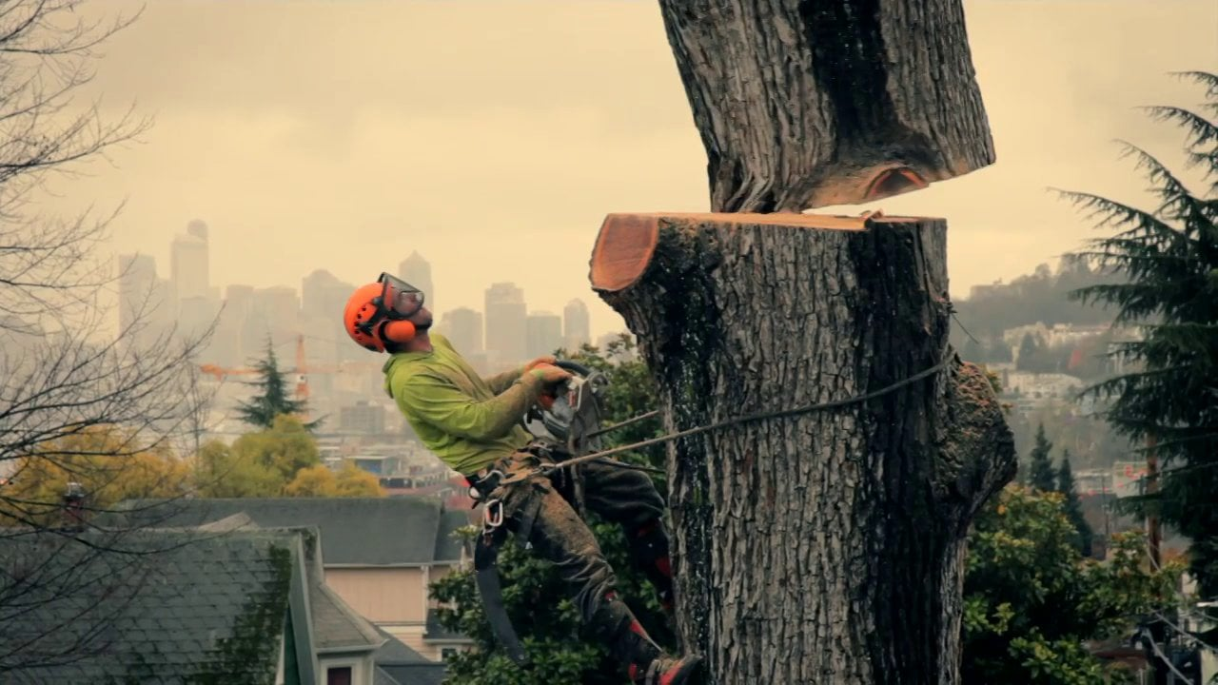
Permanence
All credited carbon must be maintained for 100 years from the time credits are issued
Unavoidable Reversals
Natural disturbances (disease, insects, wind)
Compensated for with the Buffer Pool (6%)
Avoidable Reversals
Intentional disturbances (excessive tree removals)
Compensated for by the Project Operator

Slide 19
Monitoring, reporting, and verifying project data
Annual monitoring report
Updating a project’s inventory: canopy cover and carbon stock estimates, and calculating emission reductions for the reporting period
CRTs are only issued in years that the project data are verified by a Reserve-approved 3rd party verifier
Required verification every 5 years
Project inventory data verified by 3rd party verifier
Site visits are not required if using Reserve’s default REs
Projects developing their own REs must include a site visit
Optional verification
Projects may choose to be verified in between required verifications

Slide 20
Verification
Reserve’s Verification Body accreditation program
Verifying UFM projects

Slide 21
Why is Verification Important?
Notes:
Carbon market was like the wild west without standardization for quantification and verification etc.
Verification– build market confidence and transparency. Provide objective third party assurance that project is implemented according to protocol, quantifications are accurate and conservative, follows standards, therefore real.
Ensures an even playing field
No gaming of the system/program
Uphold integrity and quality of data (reductions) reported
ensure projects are real, additional, permanent, verifiable and enforceable
minimize the risk of invalid creation or double counting of Climate Reserve Tonnes (CRTs)
support the transparency and integrity of the data contained within Reserve
maintain consistency and comparability across projects
monitor the project developer’s on-going compliance with the Reserve’s protocols

Slide 22
Accreditation Layers
International Accreditation Forum (IAF)
American National Standards Institute (ANSI)
A “IAF Body”
The
Reserve
A “reporting program” of ANSI
Notes:
At the top: the International Accreditation Forum (IAF). IAF is the world association of Conformity Assessment Accreditation Bodies. Any kind of standard-setting companies fall under IAF, not just those having to do with verification. Other examples include measurement systems and quality assurance. At the Reserve, we’re focused on the IAF verification certification standards, which includes ISO 14063, 14064, 14065, etc.
IAF accredits IAF Bodies like ANSI and EMA.
ANSI is an IAF body and has its own processes, and EMA is an IAF and has its own processes
IAF Bodies like ANSI and EMA work to accredit reporting programs
Reporting programs like the Reserve, Verra, ACR
Provides criteria for assessing and recognizing the competence of verification bodies
Allows for a consistent, comparable scheme across GHG programs
Reduces the risk to GHG programs (like the Reserve) by providing assurance that Verification Bodies are competent
Define accreditation.
According to the IAF: Accreditation is the independent evaluation of conformity assessment bodies against recognized standards to ensure their impartiality and competence. At the Reserve, we care about verification body accreditation.
Helps establish trust within the voluntary carbon market by ensuring impartiality in the verification process

Slide 23
Reserve Verification Body requirements
Minimum of two Lead Verifiers on staff
Lead Verifiers: successfully completed GVT and protocol-specific training, and they direct, supervise and lead the undertaking of the verification services
Submit a signed agreement form at least yearly, and whenever staff and roles have changed within the organization
Maintaining professional liability insurance of at least $4 million for each claim and $4 million annual aggregate
Maintain records in line with protocol requirements for at least seven years
Notes:
8 VBs accredited in our program. Not a fully comprehensive list
What’s the cycle for switching out VBs?
It should be noted by Verification Bodies that that the emissions assertions a verification body is providing a statement on may be used for purposes other than just Reserve reporting; it is therefore important that verification bodies understand the potential for reliance to be placed upon their statements by third parties, and any associated financial or legal liabilities that might accrue. Under such circumstances, verification bodies should ensure that the level of insurance carried is still appropriate.

Slide 24
Verification Training
Internal Training
Reserve Training
General Verification Training
Project-specific Trainings
Renewal cycle/process
Notes:
I’ll start by covering the relevant training for verifiers under the Reserve’s program
The first step in verification training is the verification body’s own internal training procedures and programs. This covers how to conduct verifications and lead verification activities. The VB is responsible for ensuring the verification team has the correct skills and competencies.
Reserve Training includes successfully taking and passing the related exam for both General Verification Training, which covers the topics outlined in our Program Manual and Verification Program Manual. It also includes the successful completion of the training and relevant exam for at least one project-specific training, like landfill. Once they pass the test, the certificate is valid for 3 years. At the end of the first 3 year period, the verifier will need to pass the relevant exam again, which is valid for another 3 years. Once these six years have passed, they are eligible for a one-year certificate renewal if they’ve served as a lead verifier or senior internal reviewer on at least two projects in the calendar year. If not, they need to re-take the exam again.
Renewal process: We have set processes to determine that verifiers have demonstrated continued expertise under the Reserve’s program, as well as project-specific training.

Slide 25
A rigorous feedback loop
Reserve role: oversee performance of verifiers and Verification Bodies
Internal tracking and structured, regular team discussions
Project oversight
Reserve + ANSI: a partnership
Quarterly meetings to discuss VB performance and sector news/updates
Includes other voluntary carbon registries
Rotational requirements
Projects must use a different VB every six years
Notes:
Formalized partnership with ANSI
Internal tracking
Accreditation tracking for updated protocol specific training
Specific issues: ie if VB has continual issues submitting something on time, or recurring patterns/issues/challenges. We log it and if it is recurring and does not get fixed, we bring it up during the quarterly ANSI meetings, or directly to ANSI if there is an egregious xxx
Project oversight– follow project audits
If veririfers have trouble id if issues are compliance related or not, missed deadlines, not catching onto compliance issues, materiality– sometimes if we see quantitative/qualitative issues ie material if over 5% of discrepancy between project and VB calculation

Slide 26
Verifying Urban Forest Management Projects

Slide 27
Demonstrate familiarity with standards and software
Urban Forest Management Project Protocol
Urban Forest Management Quantification Guidance
Reserve Program Manual
Reserve Verification Program Manual
Reserve software
ISO 14064-3:2006 Principles and Requirements for Verifying GHG Inventories and Projects

Slide 28
Verification items and schedules
Verification Items | Section of UFMPP | Initial | Full | Optional | Apply Professional Judgment?
1. Project Definition | 2.1 Urban Forest Management | X |  |  | No
2. Urban Forest Owner | 2.2 Urban Forest Owners | X | X |  | No
3. Project Operator | 2.3 Project Operators | X | X |  | No
4. Project Implementation Agreement | 2.4 Project Implementation Agreement | X | X | X | No
5. Project Location | 3.1 Project Location | X |  |  | No
6. Project Area | 3.2 Project Area | X |  |  | No
7. Limits to Site Preparation | 3.3 Limits to Site Preparation | X | X |  | Yes
8. Project Commencement | 3.4 Project Commencement | X |  |  | Yes
9. Additionality | 3.5.1 Legal Requirement Test 3.5.2 Performance Test | X | X |  | Yes
 | 3.5.2.1 Performance Standard for Urban Forest Management Projects | X
10.Project Crediting Period | 3.6 Project Crediting Period | X | X |  | No
11.Minimum Time Commitment | 3.7 Minimum Time Commitment | X | X |  | No
12. Social and Environmental Co-Benefits | 3.8 Social and Environmental Co-Benefits | X | X |  | Yes, for public or tribal entities only
13. Social Co-Benefits | 3.8.1 Social Co-Benefits | X | X |  | Yes, for public or tribal entities only
14. Environmental Co-Benefits | 3.8.2 Environmental Co-Benefits | X | X |  | Yes, for public or tribal entities only
15. GHG Assessment Boundaries | 4 GHG Assessment Boundaries | X | X |  | No
The verification topics below are linked to quantification requirements. The verification of project inventories is described in detail below this table. Verifiers shall assure that requirements associated with the references in this table have been satisfied and implement the specific guidance requirements for verifying inventories below.
16. Quantifying Net GHG Reductions and Removals | 5 Quantifying Net GHG Reductions and Removals Urban Forest Management Quantification Guidance | X | X | X | No
17. Urban Forest Protocol Baselines | 5.1 Urban Forest Management Baseline Urban Forest Management Quantification Guidance | X |  |  | No
18. Permanence and Buffer Pool Contributions | 6.1 Contributions to the Buffer Pool | X | X | X | No
19. Permanence and Compensating for Reversals | 6.2 Compensating for Reversals 6.2.1 Avoidable Reversals 6.2.2 Unavoidable Reversals | X | X | X | No

Slide 29
Some key verification elements
All items in previous table have been reviewed
Confirm correct project assessment area and REs
Comparison of County Assessor Parcels and GIS parcels
Site visit for projects developing project-specific REs
Verifying baseline and primary effect calculations
Project’s canopy cover estimates must be within +/- 5% at 1 standard error
Verifier’s calculation of primary effects must be within 5%* of Project estimates
Projects must re-sample estimates if verifier fails to find conformance with initial estimates after 3 tries
*on a sliding scale, based on project size. The larger the project, in terms of volume of reductions/removals, the smaller the percentage of allowable non-conformance.
Notes:
Reserve recommends replicating quantification approach of project, using same technology i.e. iTree Canopy
▪ Projects registering ≤25,000 CRTs over a 12-month period shall achieve a >95% level of accuracy (25,000 CRTs but ≤100,000 CRTs over a 12-month period shall achieve a >97% level of accuracy (100,000 CRTs over a 12-month period shall achieve a >99% level of accuracy (

Slide 30
Last steps
Detailed list of findings (private document)
Exit meeting with Project Operator
Verifiers must submit Verification Report + Verification Statement
These are public documents
Specify credit vintage and volume of reductions/removals
Submit report, statement, and list of findings to Reserve
Reserve reviews Project reports and verification reports
Reserve issues credits
Notes:
List of findings: material and immaterial findings; list for the project operator– do we see it too?
Is there a template for Verification reports? No, lots of VBs have their own templates, but very often it follows sequence of protocol (see verification items table)
Reserve has a very detailed check list for reviewing verification report, the sampling plan, verification plan, all other supporting documents

Slide 31
Thank you! Questions?

